Slide 1
JDS Capstone:
Target Market Analysis
Group 4
Ahmad Azraai
Luqman Hakim
Mohd Hidzam

Slide 2
Objective
1. Design a predictive model to determine the potential customers who will purchase if you send the advertisement . The target variable is Potential_Customer.
2. Calculate the value and the revenue of your model. Fit your model on train set. Assume among the customers on your test set we only send advertisement to those your model predicted as Class1 and we ignore the rest. From the data you can calculate the average Cust_Last_Purchase for those who are in the train set and had the last purchase (Cust_Last_Purchase>0) . Assume sending advertisement to each customer costs 5$ and the average purchase you calculated on the train set remains the same for the test set. Calculate the value of your models to choose the best model.
3. Compare your best model's revenue with the revenue of the default solution which is sending advertisement to all the customers in X_test. Which solution would you choose?
4. Assume the next time you want to target a group of 30,000 customers similar to this group. And assume the purchase rate is 10 which means 10 out of 100 people who receive the advertisement will purchase the product. Also assume your model will have the same Precision and Recall for Class1 . Will you send the advertisement to everyone, or you use one of the models you have already created?
- calculate your model's revenue on this set of 30,000 customers based on the above assumptions
- calculate the revenue of the default model: send advertisement to everyone

Slide 3
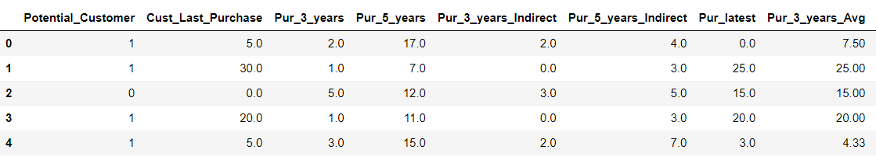
Data Cleaning
Remove $ and , sign, drop duplicates
Change datatype each column to categorical or numerical
Drop C_ID (not useful for analysis)
Dimensions of data after cleaning : (3618, 25)
First 5 records data

Slide 4
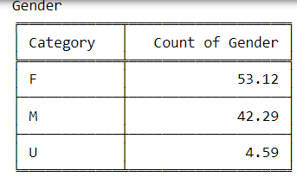
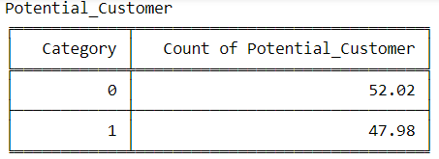
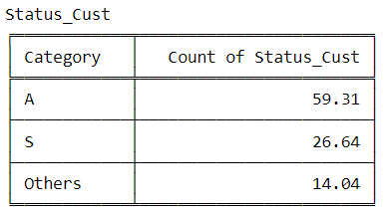
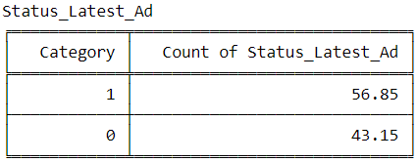
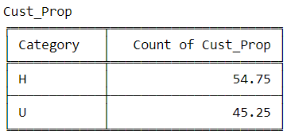
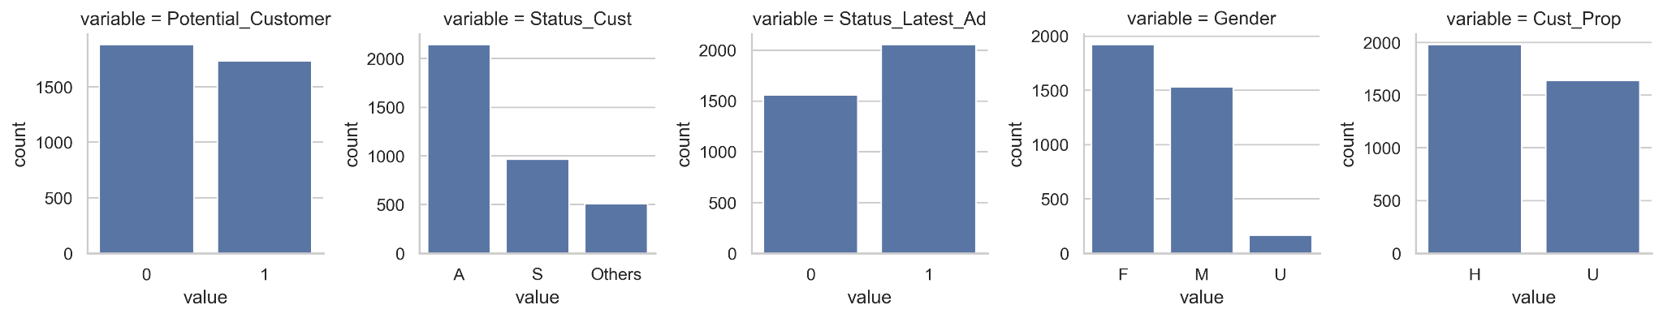
Exploratory Data Analysis (EDA)
Explore Categorical Variables
-How many categories in each categorical variables?
-What proportion/percentage from each category?
*Count typo should be percentage %

Slide 5
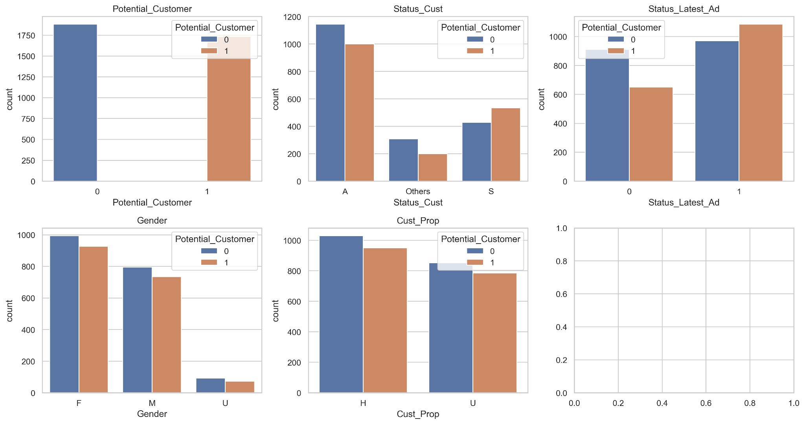

Explore Relationship Between Categorical & Target Variable. Interpret the observation
Insight
Status Customer (S) has relationship with Potential Customer
Status Latest Ad (1) has relationship with Potential Customer

Slide 6

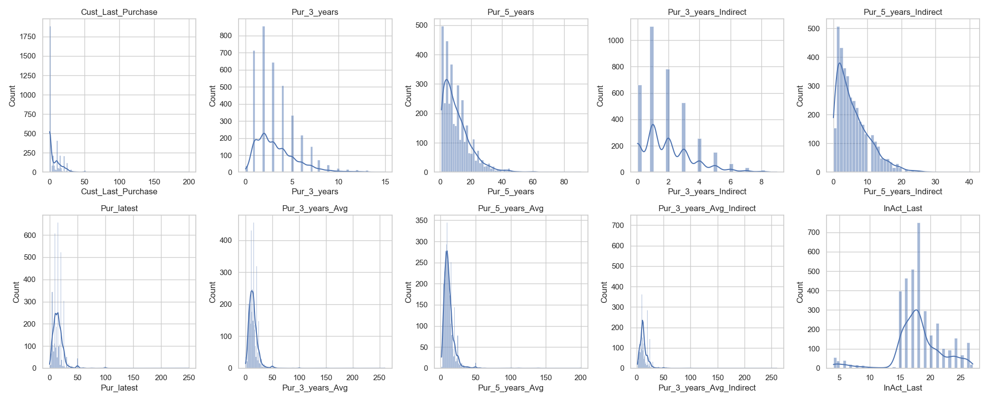
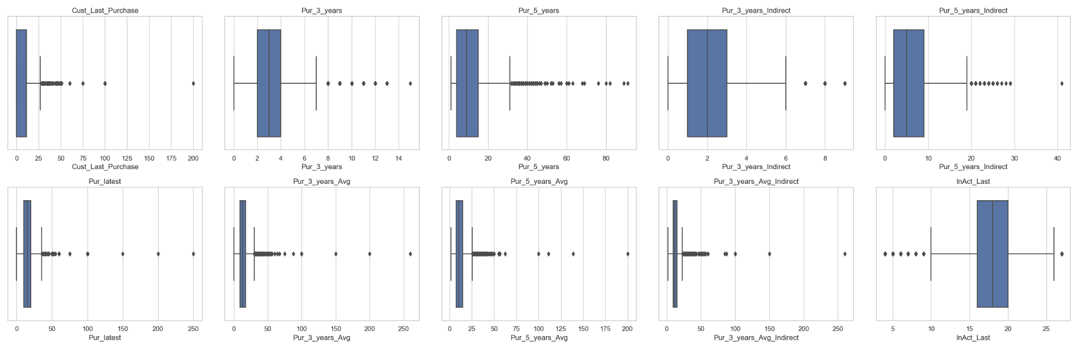
Explore Numerical Variables
Insight
Based on histogram, the data has skewness and not normally distributed
Based on boxplot, there are outliers in the data

Slide 7
Explore the Relationship between the columns and try to answer the following questions:
Is there any significant difference between men/women's salary?
-p-value: 0.002949686546935098
-There is a significant difference between men and women's salaries.
Is there any significant difference between men/women's number of the purchase in the last three years?
-p-value: 0.05342107222541828
-There is no significant difference between men and women's number of purchases in the last three years.
Is there any significant difference between men/women's average purchase in the last three years?
-p-value: 0.02911965665430551
-There is a significant difference between men and women's average purchase in the last three years.
Is there any significant difference between men/women's total purchase in the last three years?
-p-value: 0.33404528691822555
-There is no significant difference between men and women's total purchase in the last three years.

Slide 8
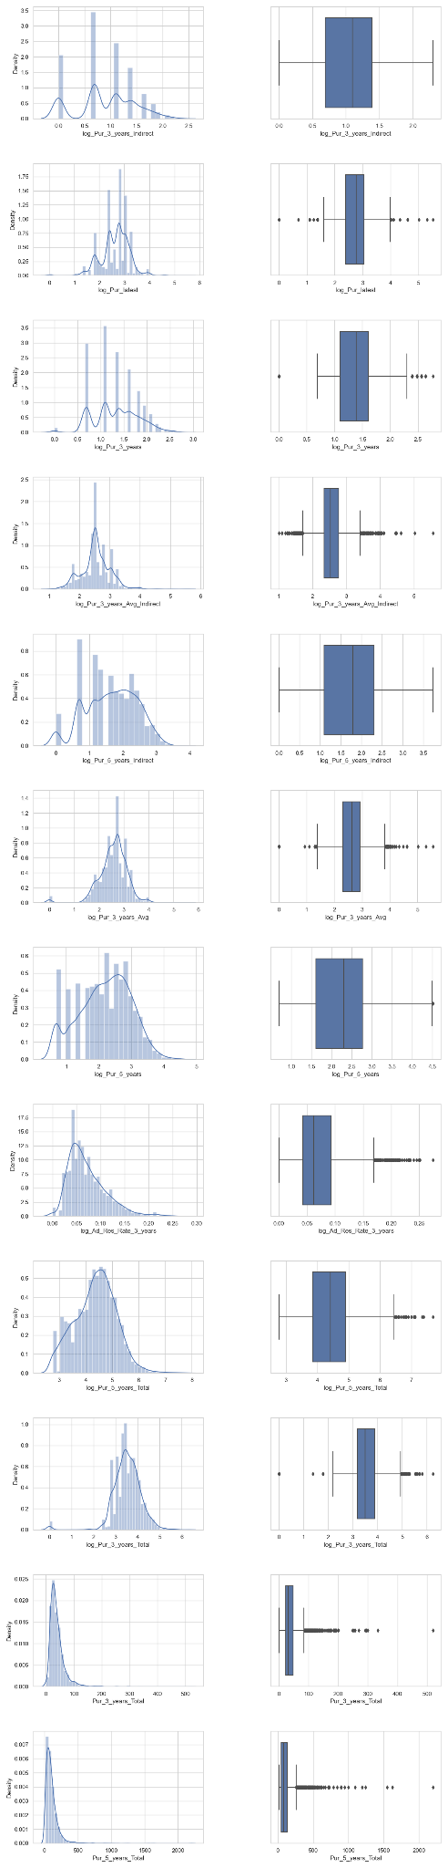
Add Some High Level Features and explore their relationship with the target variable
Insight
We use logarithm to normalize data/dimension reduction
Notes:
v

Slide 9
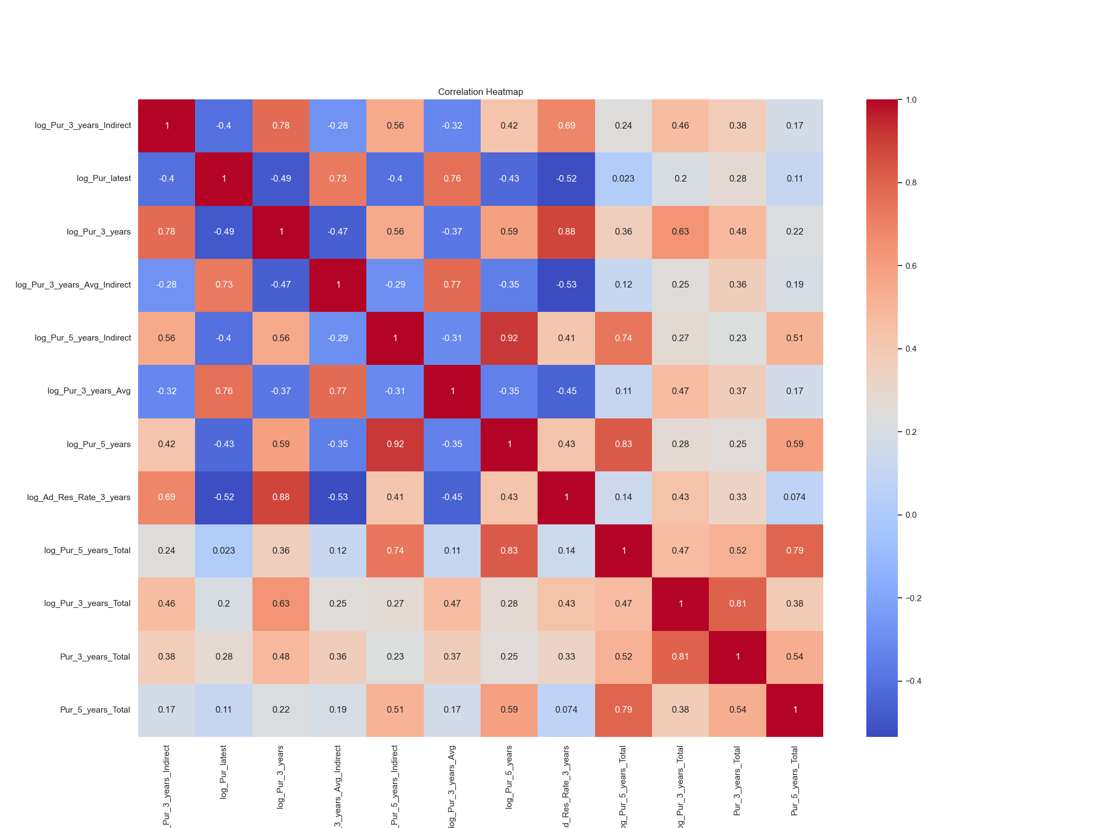
Check Correlation between Numerical Variables
Insight
Correlation is a statistical measure that indicates the degree to which two variables are related to each other.

Slide 10
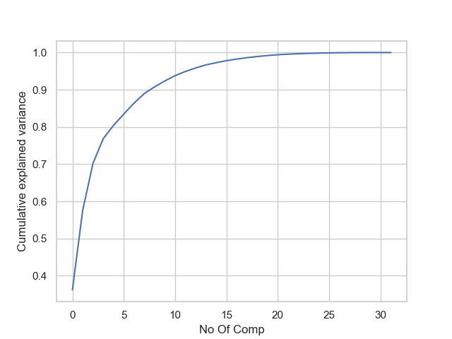
PCA on Numerical Columns only
No Of Comp Chosen: 20
Insight
We want to choose the number of components that will explain a sufficient proportion of the variance in the data while keeping the number of components as small as possible to avoid overfitting.

Slide 11
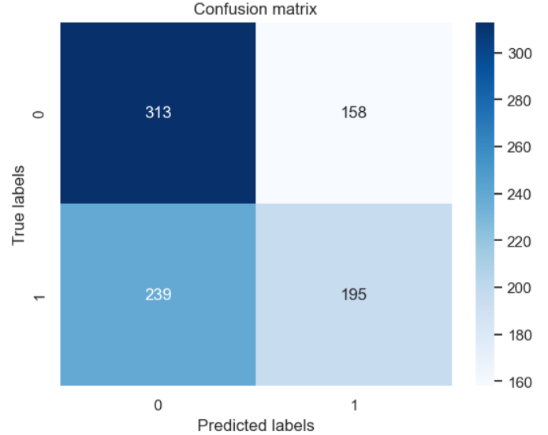
Objective 1: Machine Learning
1. Design a predictive model to determine the potential customers who will purchase if you send the advertisement . The target variable is Potential_Customer.
Apply various ML algorithms on the data, evaluate them after Grid Search and Cross Validation, and choose the best model.
Logistic Regression: 56.69%
K-Nearest Neighbors: 50.00%
Decision Tree: 50.53%
Support Vector Machine (RBF Kernel): 51.30%
Random Forest: 54.06%
The best model is: Logistic Regression
Notes:
True Positive (TP) represents the number of positive instances that are correctly predicted as positive by the model.
True Negative (TN) represents the number of negative instances that are correctly predicted as negative by the model.
False Positive (FP) represents the number of negative instances that are incorrectly predicted as positive by the model.
False Negative (FN) represents the number of positive instances that are incorrectly predicted as negative by the model.
- Accuracy: measures the proportion of correctly classified instances among all instances. It is calculated as (true positives + true negatives) / (true positives + false positives + true negatives + false negatives).
- Precision: measures the proportion of true positives among all predicted positive instances. It is calculated as true positives / (true positives + false positives).
- Recall: measures the proportion of true positives among all actual positive instances. It is calculated as true positives / (true positives + false negatives).
- F1-score: is the harmonic mean of precision and recall, providing a single score that balances both measures. It is calculated as 2 * ((precision * recall) / (precision + recall)).
In summary, accuracy measures how often the model is correct, precision measures how many of the predicted positive instances are actually positive, recall measures how many of the actual positive instances are correctly identified, and F1-score is a balance between precision and recall that can be useful when the classes are imbalanced.

Slide 12
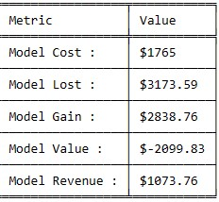
Objective 2:
2. Calculate the value and the revenue of the model
Model Cost: The cost of the model is $1765.
Model Lost: The amount lost by the model is $3173.59.
Model Gain: The amount gained by the model is $2838.76.
Model Value: The value of the model is calculated by subtracting the cost and the amount lost from the amount gained, which results in a negative value of -$2099.83.
Model Revenue: The revenue generated by the model is $1073.76.
The model has generated positive revenue, but high costs and losses outweighed the gains, resulting in a negative value. This data can help evaluate the model's performance and decide whether to continue investing or explore other options.
Notes:
True Positive (TP) represents the number of positive instances that are correctly predicted as positive by the model.
True Negative (TN) represents the number of negative instances that are correctly predicted as negative by the model.
False Positive (FP) represents the number of negative instances that are incorrectly predicted as positive by the model.
False Negative (FN) represents the number of positive instances that are incorrectly predicted as negative by the model.
- Accuracy: measures the proportion of correctly classified instances among all instances. It is calculated as (true positives + true negatives) / (true positives + false positives + true negatives + false negatives).
- Precision: measures the proportion of true positives among all predicted positive instances. It is calculated as true positives / (true positives + false positives).
- Recall: measures the proportion of true positives among all actual positive instances. It is calculated as true positives / (true positives + false negatives).
- F1-score: is the harmonic mean of precision and recall, providing a single score that balances both measures. It is calculated as 2 * ((precision * recall) / (precision + recall)).
In summary, accuracy measures how often the model is correct, precision measures how many of the predicted positive instances are actually positive, recall measures how many of the actual positive instances are correctly identified, and F1-score is a balance between precision and recall that can be useful when the classes are imbalanced.

Slide 13
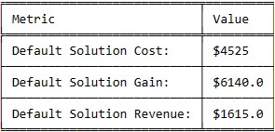
Objective 3:
3. Compare your best models' revenue with the revenue of the default solution which is sending advertisement to all the customers in X_test
The first row shows the cost of the default solution which is $4525.
The second row indicates the gain from the solution which is $6140.0.
The third row represents the revenue generated from the default solution which is $1615.0.
The default solution shows a positive revenue of $1615.0
Model Revenue: The revenue generated by the model is $1073.76. Solution: Send ads to all customers
Notes:
True Positive (TP) represents the number of positive instances that are correctly predicted as positive by the model.
True Negative (TN) represents the number of negative instances that are correctly predicted as negative by the model.
False Positive (FP) represents the number of negative instances that are incorrectly predicted as positive by the model.
False Negative (FN) represents the number of positive instances that are incorrectly predicted as negative by the model.
- Accuracy: measures the proportion of correctly classified instances among all instances. It is calculated as (true positives + true negatives) / (true positives + false positives + true negatives + false negatives).
- Precision: measures the proportion of true positives among all predicted positive instances. It is calculated as true positives / (true positives + false positives).
- Recall: measures the proportion of true positives among all actual positive instances. It is calculated as true positives / (true positives + false negatives).
- F1-score: is the harmonic mean of precision and recall, providing a single score that balances both measures. It is calculated as 2 * ((precision * recall) / (precision + recall)).
In summary, accuracy measures how often the model is correct, precision measures how many of the predicted positive instances are actually positive, recall measures how many of the actual positive instances are correctly identified, and F1-score is a balance between precision and recall that can be useful when the classes are imbalanced.

Slide 14

Objective 4:
4- calculate your model's revenue on this set of 30,000 customers
The revenue generated by the "Model" solution is $200,056, while the revenue generated by the "Default" solution is $42,173.2.
The table compares the total revenue generated by the model and the default solution, showing that the model solution generates significantly higher revenue of $200,056 compared to the default solution's $42,173.
This indicates that utilizing the model for decision-making could result in a more positive outcome.
Notes:
True Positive (TP) represents the number of positive instances that are correctly predicted as positive by the model.
True Negative (TN) represents the number of negative instances that are correctly predicted as negative by the model.
False Positive (FP) represents the number of negative instances that are incorrectly predicted as positive by the model.
False Negative (FN) represents the number of positive instances that are incorrectly predicted as negative by the model.
- Accuracy: measures the proportion of correctly classified instances among all instances. It is calculated as (true positives + true negatives) / (true positives + false positives + true negatives + false negatives).
- Precision: measures the proportion of true positives among all predicted positive instances. It is calculated as true positives / (true positives + false positives).
- Recall: measures the proportion of true positives among all actual positive instances. It is calculated as true positives / (true positives + false negatives).
- F1-score: is the harmonic mean of precision and recall, providing a single score that balances both measures. It is calculated as 2 * ((precision * recall) / (precision + recall)).
In summary, accuracy measures how often the model is correct, precision measures how many of the predicted positive instances are actually positive, recall measures how many of the actual positive instances are correctly identified, and F1-score is a balance between precision and recall that can be useful when the classes are imbalanced.

Slide 15
Recommendations
For building an effective ML system, it is crucial to choose the appropriate model. To achieve this, explore various models and compare their performance to determine the best fit for the problem at hand.
Improving an ML model significantly relies on the quantity and quality of the training data. Enhancing the data can be accomplished by obtaining more data or enhancing the quality of the existing dataset.
Change the target variable from Potential Customer to other target such as Age, Annual Income, Gender and House Ownership
Notes:
True Positive (TP) represents the number of positive instances that are correctly predicted as positive by the model.
True Negative (TN) represents the number of negative instances that are correctly predicted as negative by the model.
False Positive (FP) represents the number of negative instances that are incorrectly predicted as positive by the model.
False Negative (FN) represents the number of positive instances that are incorrectly predicted as negative by the model.
- Accuracy: measures the proportion of correctly classified instances among all instances. It is calculated as (true positives + true negatives) / (true positives + false positives + true negatives + false negatives).
- Precision: measures the proportion of true positives among all predicted positive instances. It is calculated as true positives / (true positives + false positives).
- Recall: measures the proportion of true positives among all actual positive instances. It is calculated as true positives / (true positives + false negatives).
- F1-score: is the harmonic mean of precision and recall, providing a single score that balances both measures. It is calculated as 2 * ((precision * recall) / (precision + recall)).
In summary, accuracy measures how often the model is correct, precision measures how many of the predicted positive instances are actually positive, recall measures how many of the actual positive instances are correctly identified, and F1-score is a balance between precision and recall that can be useful when the classes are imbalanced.

Slide 16

THANK YOU

